Slide 1
LATENT SEMANTIC INDEXING
BY
SINGULAR VALUE DECOMPOSITION

Slide 2
PROBLEMS IN LEXICAL MATCHING
Synonymy
- widespread synonym occurances
-decrease recall.
Polysemy
- retrieval of irrelevant documents
- poor precision
Noise
- Boolean search on specific words
- Retrieval o contently unrelated documents
Notes:
SYNONYMY: The widespread occurrences of synonyms tends to decrease the recall
performance of retrieval systems. Since it will not be possible
to hit the documents with synonym words, any way.
POLYSEMY: Consequently retrieval of irrelevant documents due to
polysemy is one important factor of poor precision
NOISE: Since search is performed in a Boolean manner on the specific
words in the user query and the results of the search are not ranked
according to their relative similarity to the query. Thus there exists
so much noise in the retrieved collection due to retrieval of less similar documents

Slide 3
MOTIVATION FOR LSI
To find and fit a useful model of the relationships between terms and documents.
To find out what terms "really" are implied by a query .
LSI allow the user to search for concepts rather than specific words.
LSI can retrieve documents related to a user's query even when the query and the documents do not share any common terms.
Notes:
LSI MOTIVATION:
The goal in LSI is to find and fit a useful model of the relationships
between terms and documents. We want to use the matrix of observed
occurrences of terms in documents to estimate parameters of that model.
With resulting model we can then estimate what the observed occurrences
really should have been. In this way, for instance, we may be able
to predict that a given term should have been associated with a document,
even though, because of variability in word use, no such association was
observed explicitly.

Slide 4

EXAMPLE
Q : “Light waves.”
D₁: “Particle and wave models of light.”
D₂: “Surfing on the waves under star lights.”
D₃: “Electro-magnetic models for fotons.”

Slide 5
HOW LSI WORKS?
uses multidimensional vector space to place all documents and terms.
Each dimension in that space corresponds to a concept existing in the collection.
Thus underlying topics of the document is encoded in a vector.
Common related terms in a document and query will pull document and query vector close to each other.

Slide 6
DRAWBACK!
The complexity of the LSI model obtained from truncated SVD is costly.
Its execution efficiency lag far behind the execution efficiency of the simpler, Boolean models, especially on large data sets.

Slide 7
SVD
The key to working with SVD of any rectangular matrix A is to consider AA^{T} and A^{T}A.
The columns of U, that is t by t, are eigenvectors of AA^{T},
The columns of V, that is d by d, are eigenvectors of ATA.
The singular values on the diagonal of S, that is t by d, are the positive square roots of the nonzero eigenvalues of both AA^{T} and A^{T}A.

Slide 8
SVD
Eigenvalue-eigenvector factorization
A = USV^{T}
- UU^{T}=I
-VV^{T}=I
-S singular values

Slide 9
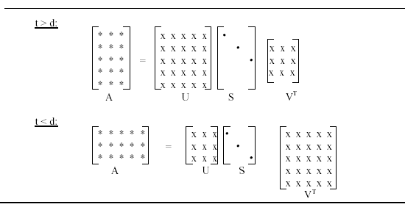
SVD-PROPERTY
Diagonals are ordered in magnitude:
s1 >= s2 ....>= sr > sr+1 =...=sr=0.
Truncated A_{k} is best approximation.

Slide 10
COMPUTING SVD
T = AA^{T} and D = A^{T}A :
Eigenvector and Eigenvalue computation for T and D

Slide 11





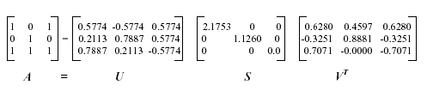
COMPUTING SVD(2)

Slide 12
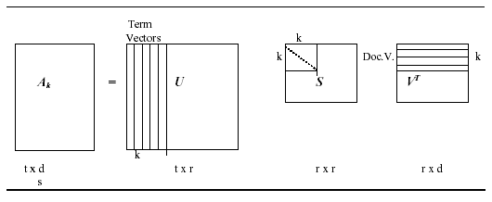
TRUNCATED-SVD
Create a rank-k approximation to A,
k < r_{A} or k = r_{A} ,
A_{k} = U_{k} S_{k} V^{T}_{k}

Slide 13
TRUNCATED-SVD
Using truncated SVD, underlying latent structure is represented in reduced-k dimensional space.
Noise in word usage is eliminated,

Slide 14
LSI-PROCEDURE
Obtain term-document matrix.
Compute the SVD.
Truncate-SVD into reduced-k LSI space.
-k-dimensional semantic structure
-similarity on reduced-space:
-term-term
-term-document
-document-document

Slide 15
QUERY PROCESSING
Map the query to reduced k-space
q’=q^{T}U_{k}S⁻¹_{k},
Retrieve documents or terms within a proximity.
-cosine
-best m

Slide 16
UPDATING
Folding-in
d’=d^{T}U_{k}S⁻¹_{k}
₋ similar to query projection
SVD re-computation

Slide 17
EXAMPLE:COLLECTION
Label Course Title
C1 Parallel Programming Languages Systems
C2 Parallel Processing for Noncommercial Applications
C3 Algorithm Design for Parallel Computers
C4 Networks and Algorithms for Parallel Computation
C5 Application of Computer Graphics
C6 Database Theory
C7 Distributed Database Systems
C8 Topics in Database Management Systems
C9 Data Organization and Management
C10 Network Theory
C11 Computer Organization

Slide 18
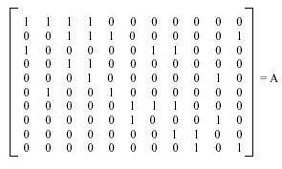
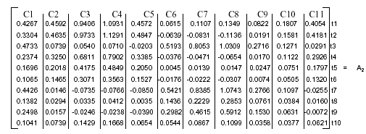
A VERSUS A₂

Slide 19
OBSERVATIONS
Lower entry values.
Higher values.
Negative Entries.

Slide 20
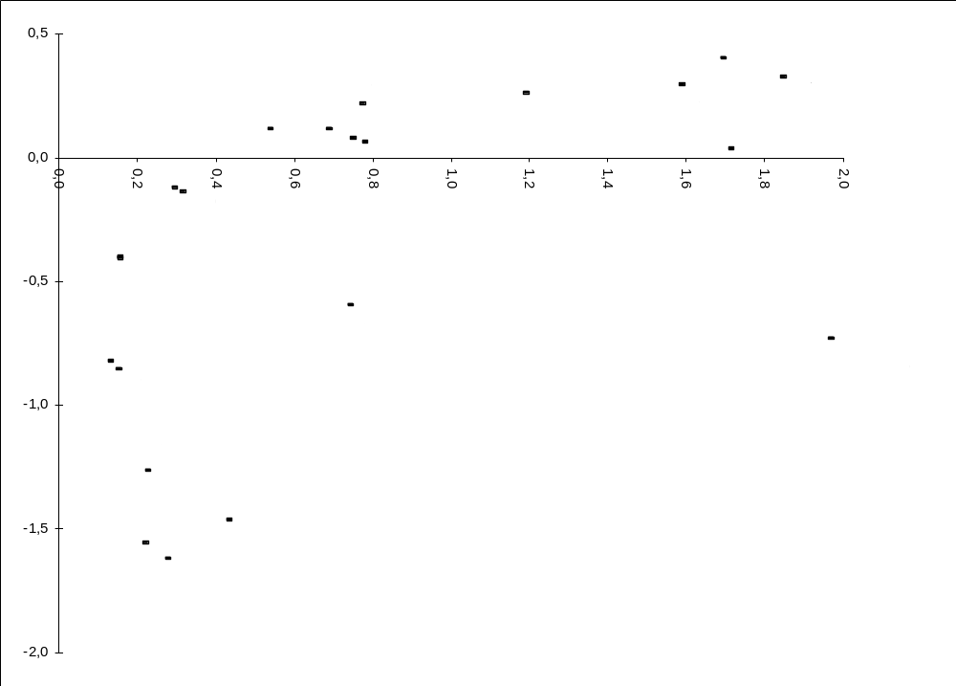
MAPPING

Slide 21
EXAMPLE:QUERY AND NEW TERMS
Query:computer database organizations
q^{T} = [ 0 1 0 0 0 0 1 0 0 1 ].
Update:
Label Course Title
C12 Parallel Programming for Scientific Computations
C13 Data Structures for Parallel Programming

Slide 22
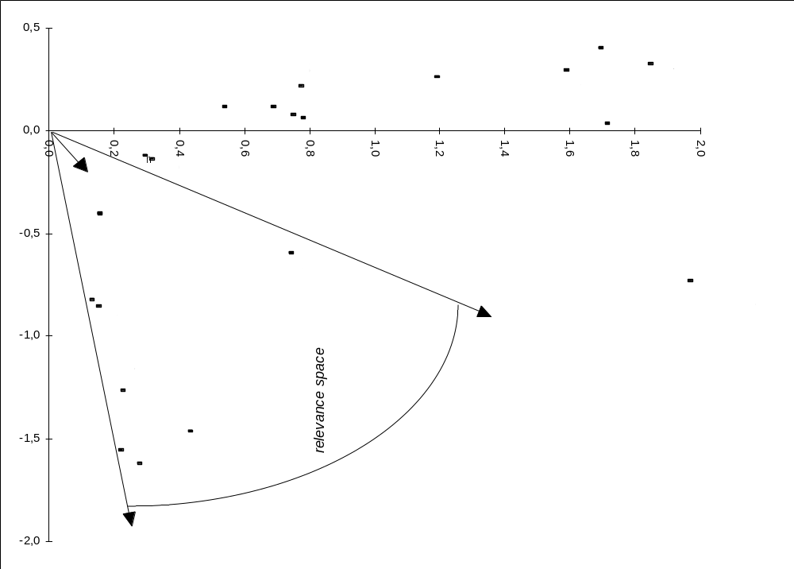
QUERY

Slide 23
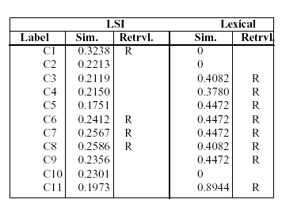
COMPARISON WITH LEXICAL MATCHING

Slide 24
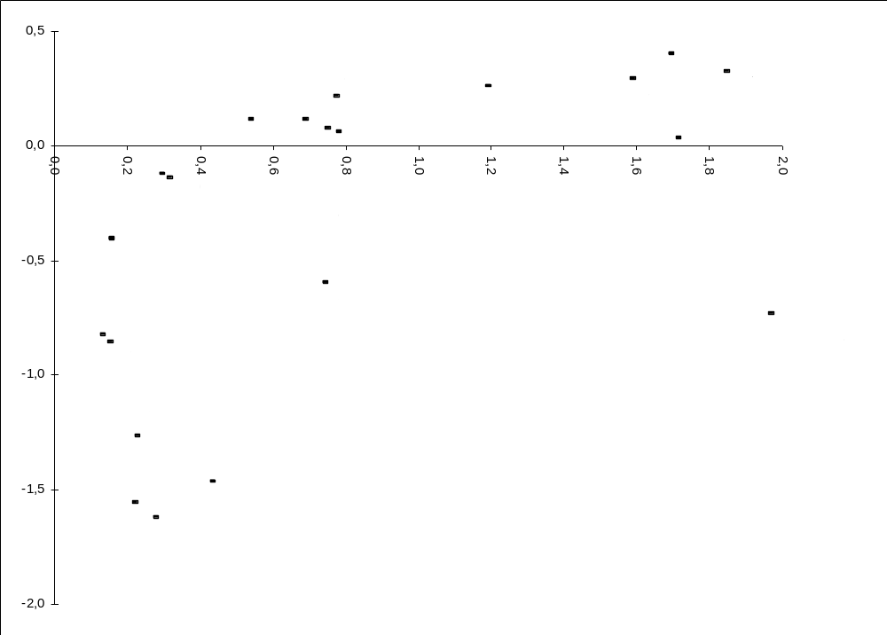
FOLD-IN

Slide 25
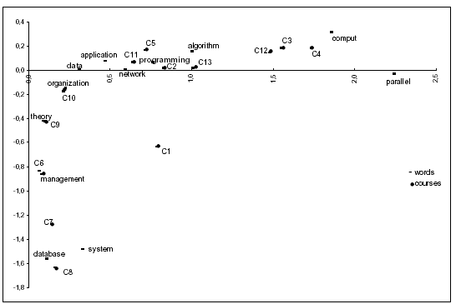
RECOMPUTED SPACE

Slide 26
SOME APPLICATIONS
Information Retrieval
Information Filtering
Relevance Feedback
Cross-language retrieval

